Slide 1


Skill Advanced Course-1
ANDROID DEVELOPMENT

Slide 2

Team Details:
1.A.Pavan Kumar
2.B.Lokesh
3.D.Chanakya
4.G.Soniraj
5.K.Sravanti
6.Likith Panigrahi
7.S.Sasi Kumar
8.P.Dinesh
9.T.Yashswini
10.T.Joshith Kumar
11.T.Urmila
12.L.Manisha

Slide 3

ADITYA INSTITUTE OF TECHNOLOGY AND MANAGEMENT
(An Autonomous Institute)
Approved by AICTE, permanently affiliated to JNTUGV
Accredited by NBA & NAAC A+
Recognized by UGC under section 2(f) & 12(b)
Tekkali,Andhra Pradesh

Slide 4

Introduction to Android Development
Android app development has changed a lot with new tools and framework.
Kotlin is now the favorite language for making Android apps because it's easy to write, safe, and works well with Java.
Jetpack Compose is a new tool from Google that makes building user interfaces (UI) easier.
It lets developers create native interfaces in a simpler way, making it faster to design and update apps

Slide 5

Why Android OS?
It comes tightly integrated with Google's services such as Gmail.
Android is an open-source operating system. It allows developers to customize Android for their devices.
It is the most widely used mobile operating system, with over 3 billion active users globally. Google Drive, Google Maps, and the Play Store, which enhances user experience and productivity.
Android runs on a wide range of devices from different manufacturers.
Android offers a wide range of customization possibilities for both developers and users.

Slide 6
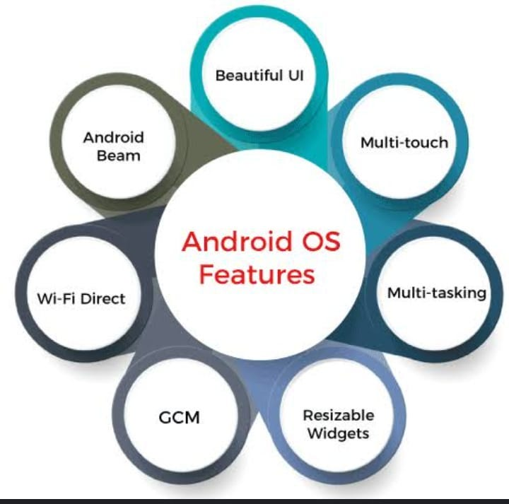
Key Features Of Android OS
1.Personalization
2.Connectivity
3.Productivity
4.Media
5.Privacy
6.Security
7.Accessibility

Slide 7

Android Studio:
Android Studio is an Integrated Development Environment (IDE) which was introduced by Google, specifically designed for application development. Android Studio is preferred more by most of the developers for several reasons:
● Official Support
● Complete tooling
● Gradel Integration
● Emulator and Device Testing
● UI design tools
● Code suggestions and Refactoring
● Version control integration
● Community & Resources

Slide 8

Installing Android Studio:
1.Download Android studio
- Go to developer.android.com
- Clock “Download Android Studio”
2.Run the Installer
- Open the downloaded .exe file
- Select “Yes” if prompted to allow changes on your device
3.Choose Installation options
- Select the “Standard” installation for default settings
- Confirm the installation path
4. Install Components
- Let the installer download and install required SDK tools and emulators
5. Launch and Configure
- Open Android Studio
- Complete any initial configurations and updates

Slide 9

Setting up Android Studio for development:
Select the Project template
Choose the ‘Empty Activity’ template to start your new project.
Name your project
Provide a suitable name for your project such as ‘Greeting card’.
Follow the setup wizard
Configure the package name and choode a location to save your project.
Choose minimum SDK version
Select the minimum SDK version, for eg: API 24:Android 7.0.
Finish project configuration
Click finish and allow android studio to configure your new project.

Slide 10

Kotlin Overview:
Kotlin is a modern programming language by JetBrains which is a combination of Python and Java. It's the top choice for Android app development because it's easy to read and has powerful features.
Why We Use Kotlin?
➢ Conciseness:
➢ Null Safety:
➢ Interoperability:
Advantages of Kotlin:
Less Code, More Efficienct
Enhanced Readability
Improved Performance
Google Support
Disadvantages of Kotlin:
Steep learning curve
Limited Resource Available
Slow Compilation Speed
Smaller Community Support

Slide 11
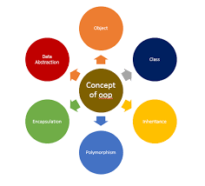
Oops In Kotlin Language:
Object oriented programming(oop) is a powerful paradigm that helps us organize code into reusable and modular units.
Concepts:
1.Classes
2.Objects
3.Inheritance
4.Polymorphism
5.Abstraction
6.Encapsulation
Benefits of OOP in Kotlin:
1.Code Reusability
2.Modularity
3.Data Security
4.Flexibility

Slide 12
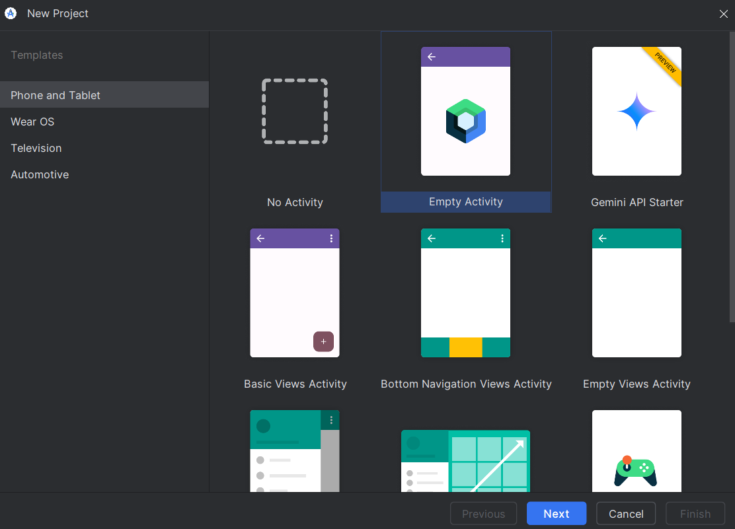

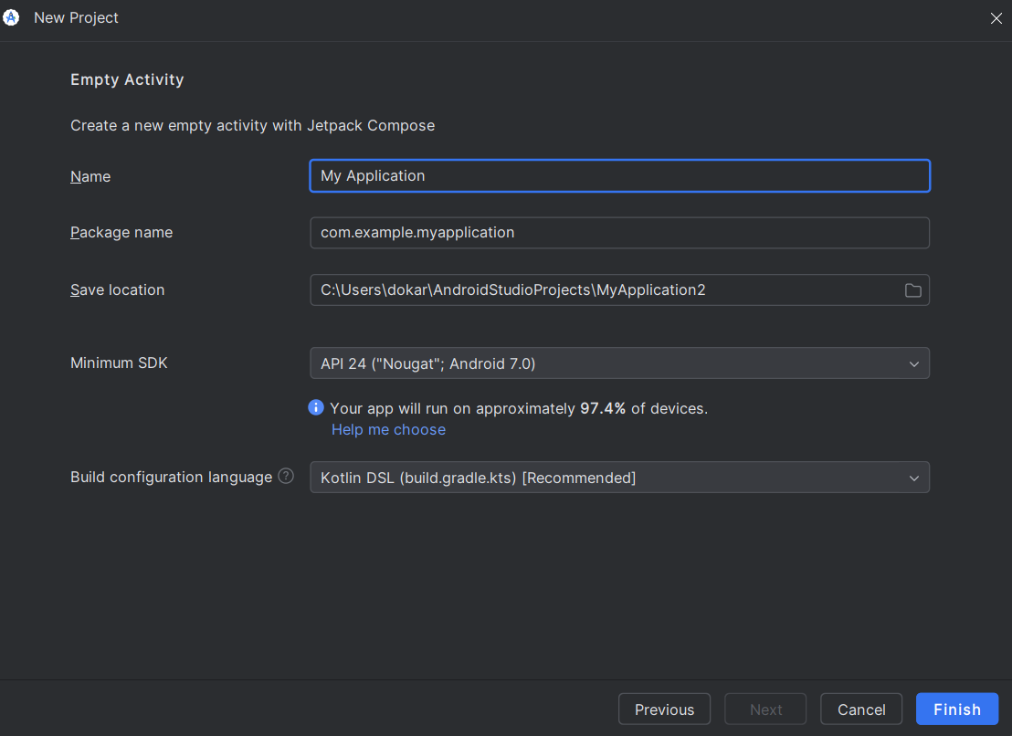
To Create App:
3.Set up your Project Structure
4.Design the user Interface
5.Add Functionality
6.Run your app
7.Debug and Test
8.Build & Release
1.Install Android Studio
2.Start a new project
a.Click on new project
b.Empty Activity
c.Configure Project

Slide 13
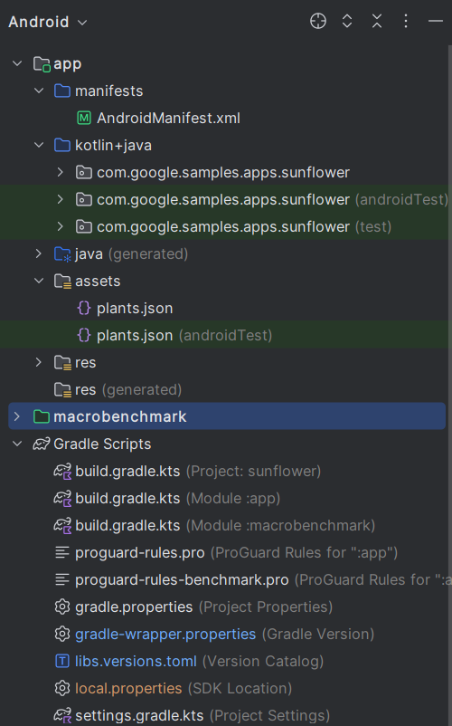
File Structure of Android app:
Tools in window bar:
Logcat:
Used for debugging purposes when an app
is in run mode then all changes made are shown here.
Problem:
This shows the errors in our code.
Terminal:
This can be simply stated as a command prompt.
Version Control:
Controls version changes.

Slide 14
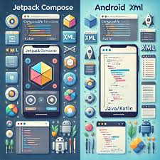
Jetpack Compose:
Jetpack compose is a modern toolkit for building native Android UIs.It offers a declarative approach to UI development,using Kotlin to define the UI and its state.This allows for more concise,readable and maintainable code.
Benefits:
1.Increased code reusability
2.Improved Performance
3.Enhanced Developer Productivity
Key Concepts:
● Easy UI Development: Simplifies creating UIs with Kotlin.
● Declarative Syntax: Build UIs based on state, making them dynamic.
● Reusable Components: Use composable functions for modular design.
● Predefined Packages: Access Material Design components for quick setup.
● Live Previews: Instant previews in the IDE facilitate faster iterations.

Slide 15
Key Terms of JetPack Compose:
OnCreate: OnCreate is a lifecycle method in Android that is called when an activity is first created.
Edge-to-Edge: The Edge-to-Edge feature allows developers to create full-screen layouts extending to the screen's edges, including areas around system bars (like the status and navigation bars).
SetContent: It allows developers to define the UI using composable functions.
Within onCreate, we use the setContent function to define the UI using composable functions.
Instead of using XML for UI layouts, setContent sets the content of the activity through Kotlin code.
Scaffold: Scaffold defines layout structure with common UI elements effectively. It creates space on the screen to align and manage components.

Slide 16
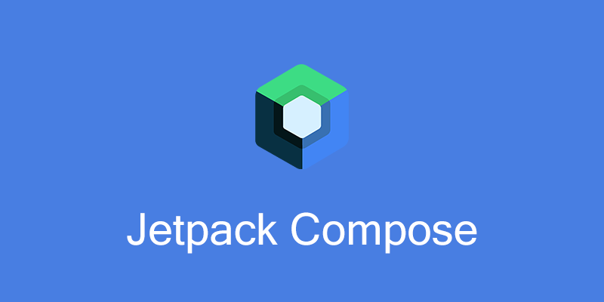
Modifier: Modifier customizes UI elements' properties like size and padding.
It enhances appearance and behaviour without acting as a container.
@Composable: @Composable defines functions that describe UI elements declaratively. It allows creating reusable UI components in Jetpack Compose easily.
@Preview: @Preview shows a composable function in the design view. It helps visualize UI changes without running the app.

Slide 17
Using UI Elements in Jetpack Compose:
Text:
Text is a composable function used to display text on the screen. You can customize the font size, color, and style.
Padding:
Padding is used to provide spacing inside or around a composable element. In Jetpack Compose, Modifier.padding is used to add padding. Mutable State:
Mutable state allows the UI to react to changes in data. In Jetpack Compose, remember and mutableStateOf are used to create reactive UI components.
Size and Font Styles:
You can define the size and font style of text or other elements using Modifier.size and TextStyle.
Buttons:
Buttons are interactive components in Jetpack Compose. The Button composable allows adding clickable buttons to the UI.

Slide 18
Creating a Card:
A Card is a UI component that displays content and actions related to a single topic.
It offers a clean surface with material design aesthetics, including elevation for depth perception.
Inserting an Image:
The Image composable is used to display images in the UI.
Images can be loaded from resources, drawable files, or external URLs using libraries like Coil.
Inserting Text:
The Text composable is used to render text in the UI.
It allows for various styling options, including font size, colour, and alignment. <<<-Cards can contain images and text, creating a cohesive and visually appealing layout->>>

Slide 19
UI Hierarchy and Box Layouts in Jetpack Compose:
UI Hierarchy:
In JetPack Compose, the UI hierarchy is built using a composables tree, where each composable function represents a UI element.It serves as the root, and subsequent composables are nested within each other using function calls to define the layout and visual elements of the user interface.
Box Layouts:
In JetPack Compose, Box Layouts(box,column,row and boxscope) are pre-built composable functions that allow developers to arrange UI elements in horizontal(row),vertical(column) or nested(box) arrangements, providing flexibility and simplicity in designing user interfaces.

Slide 20

Our Android App on

Slide 21
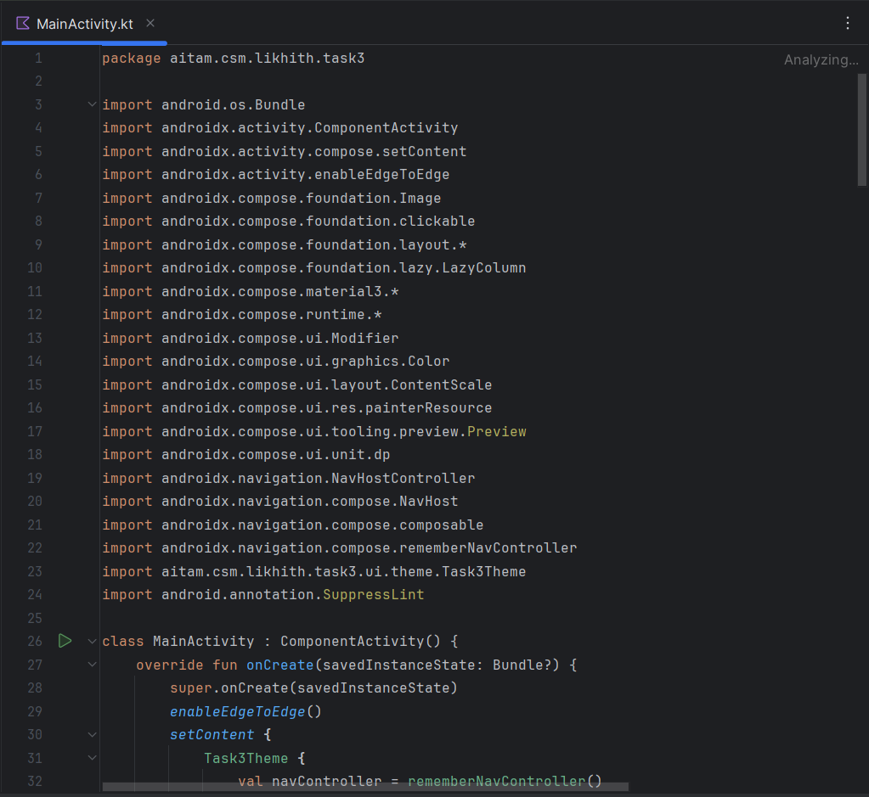
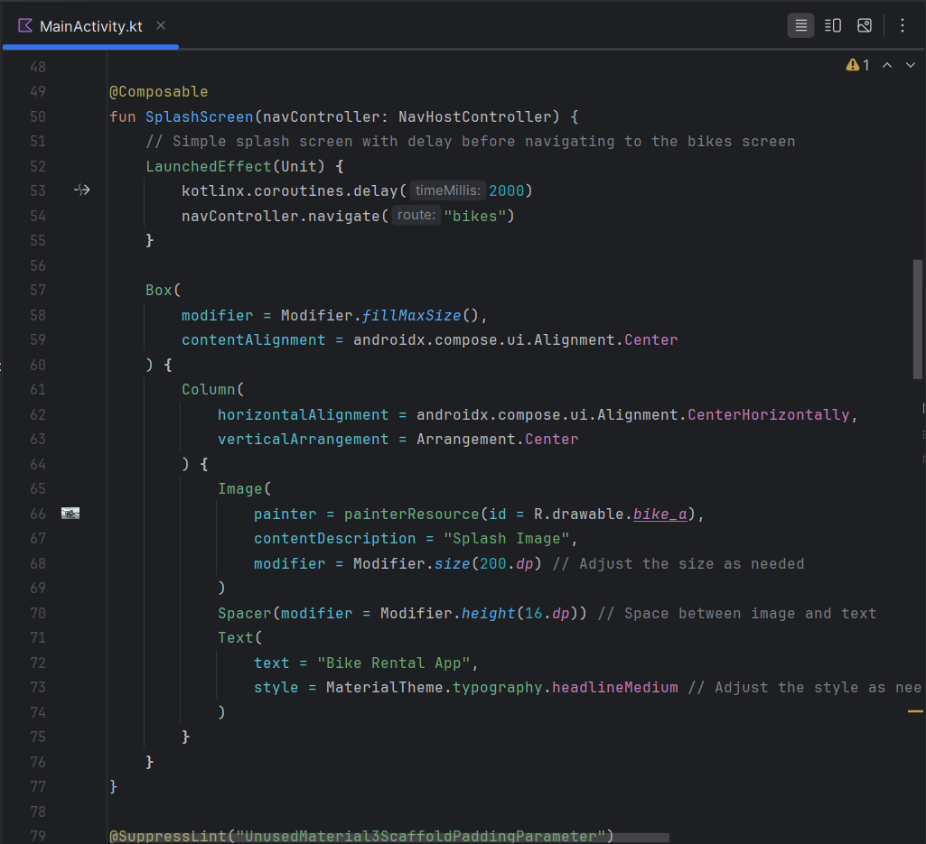
CODE BASE

Slide 22
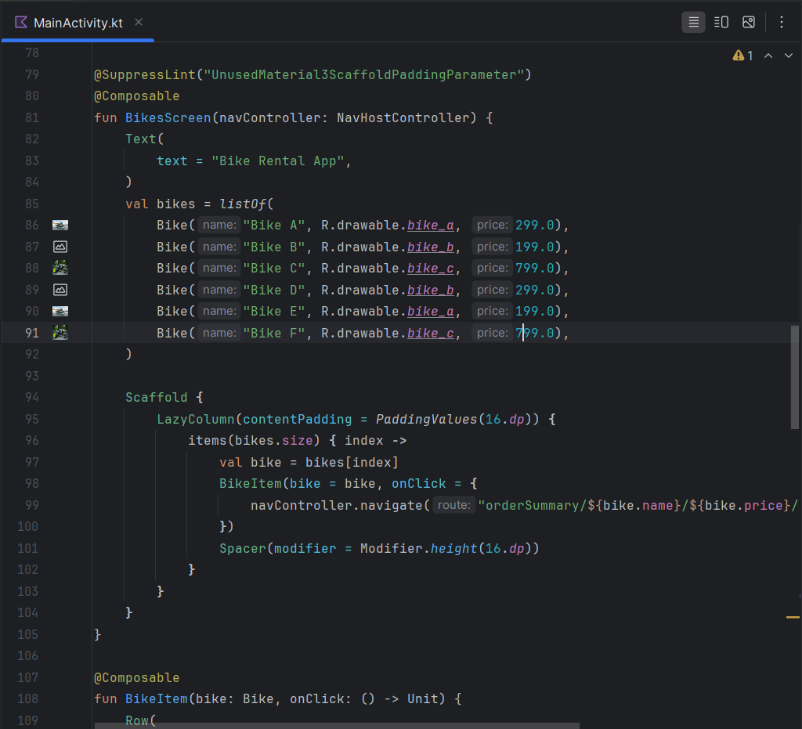
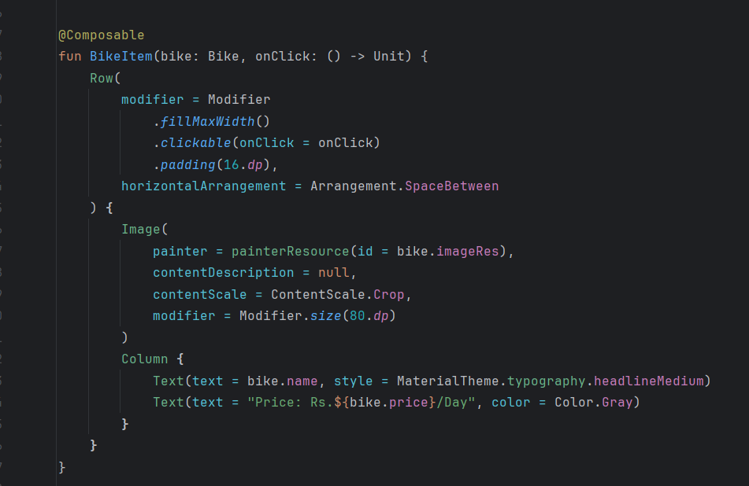
CODE BASE

Slide 23
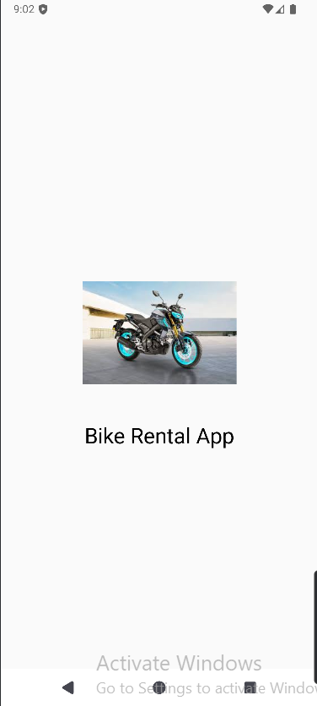
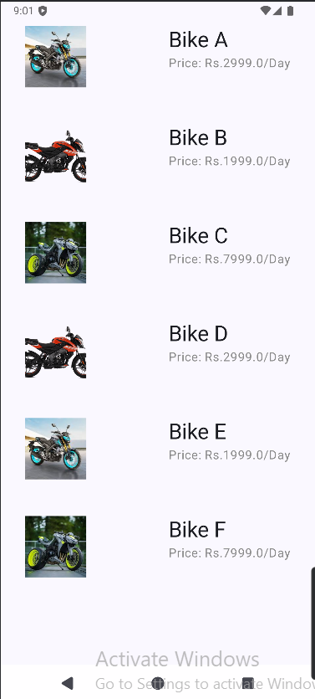
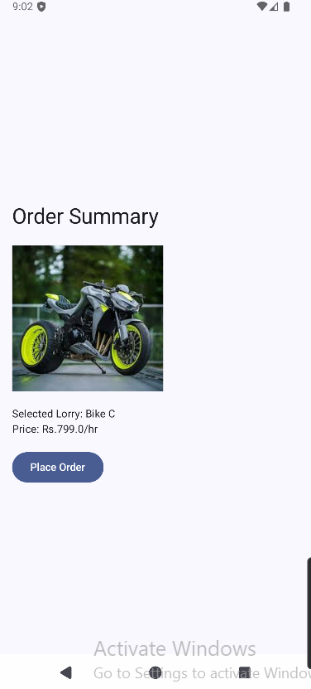
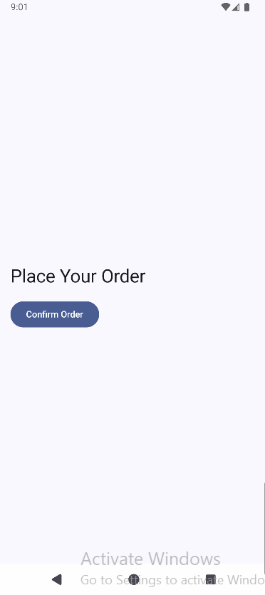
BIKE RENTAL APP

Slide 24


